Slide 1

Optimizing Microservice Interactions by Principles
This Photo by Unknown Author is licensed under CC BY

Slide 2
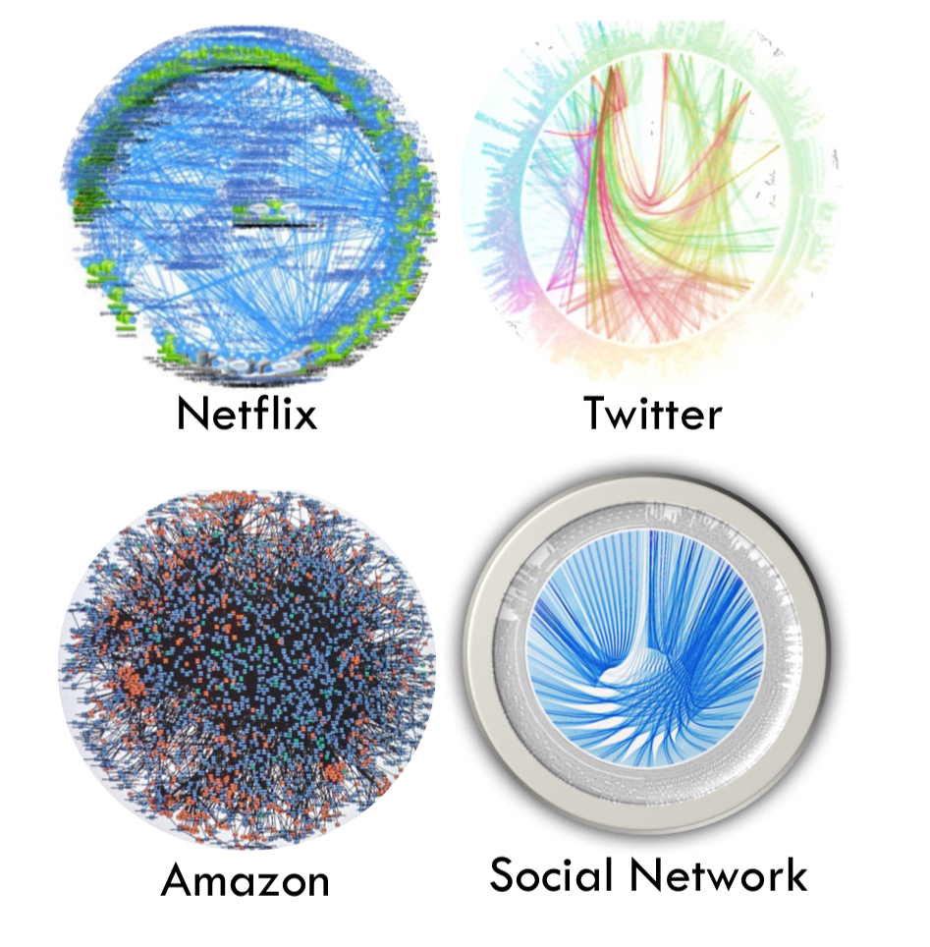
Death Star Architecture

Slide 3

WHY?

Slide 4
Characteristics
Independently Deployable
Polyglot
Autonomous

Slide 5

NETWORK CALL
Notes:
No SRP, no microservice size, etc…

Slide 6
Driving Forces
availability
reliability
latency
queuing theory
Conway’s law

Slide 7
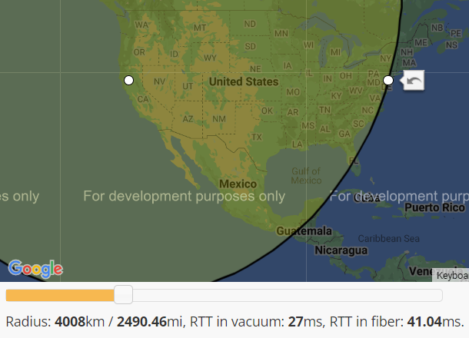
Latency
Notes:
Density of the material
Fiber is 1.5x slower
Eventual Consistency
Pressure increasing replication latency leads to increase of replication lag

Slide 8
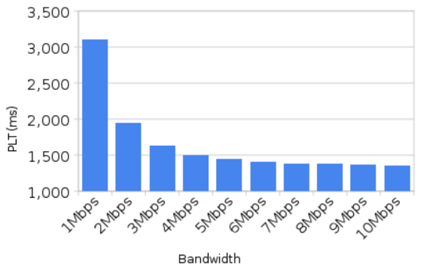
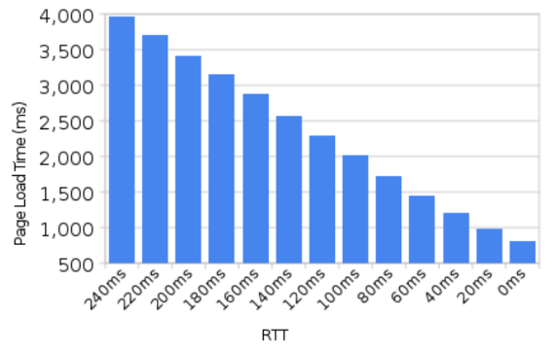
Latency
Notes:
https://tech-lagoon.com/imagechef/en/white-to-transparent.html

Slide 9
Availability
96%
99%
99%
CPU
RAM
99%
Network
Disk
99%

Slide 10
Availability
88.5%
99%
99%
99%
99%
99%
99%
99%
99%
99%
99%
99%
99%
CLIENT
SERVER
DB

Slide 11
Reliability
CPU
RAM
CPU
RAM
Network
Network
Disk
Disk
CLIENT
SERVER
Notes:
2PC !!!
TCP leaky abstraction
CAP theorem
Timeouts
Retries
Idempotence
Rapid-Read protection

Slide 12
Reliability

Slide 13
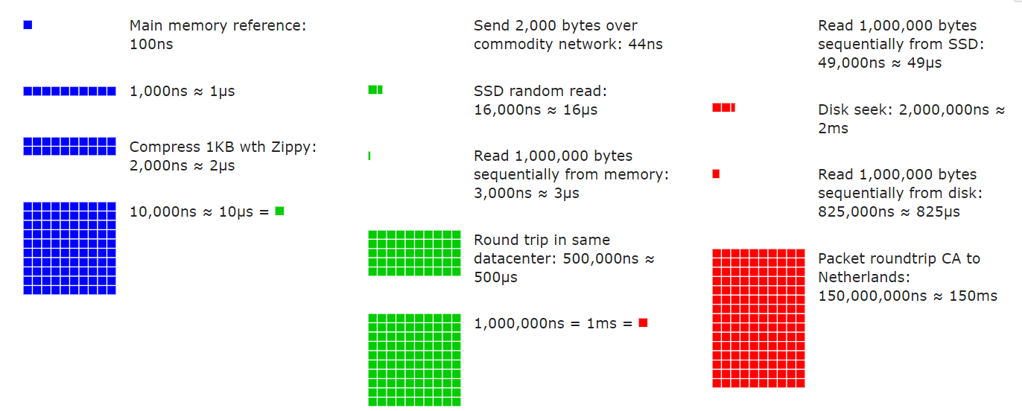
Latency Numbers Every Programmer Should Know

Slide 14
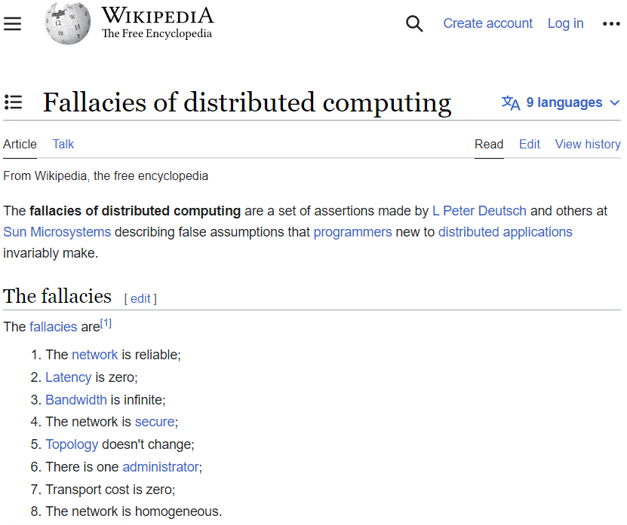
Notes:
Sun Microsystems
- CAP theorem

Slide 15
Queuing Theory
processing
time
latency
arrival rate
exit rate

Slide 16
Queuing Theory
>
arrival rate
exit rate
backpressure!
Notes:
Latency increase infinitely
Utilization > 1 (arrival/exit)

Slide 17
Queuing Theory
100ms
latency = 800ms
10/s

Slide 18
Queuing Theory
100ms
latency = 400ms
100ms
20/s

Slide 19
Queuing Theory
50ms
50ms
latency = 800ms
20/s

Slide 20
Queuing Theory
100ms
50ms
latency = 1200ms
10/s

Slide 21
Queuing Theory
latency = sum(processing time / parallelism) * queue length
throughput = min(parallelism / processing time)

Slide 22
Queuing Theory
QoS?

Slide 23
Queuing Theory
QoS
QoS
QoS

Slide 24

Conway’s Law

Slide 25

Conway’s Law

Slide 26

Conway’s Law

Slide 27
Conway’s Law
Schema Owner

Slide 28
Conway’s Law
Schema Owners

Slide 29

Conway’s Law
Schema
Federation

Slide 30
TOOLBOX

Slide 31

CQRS
SCHEMAS
CONTRACT-BASED TESTS
SYNC TO ASYNC
POLLING, FAKE BOUNDARIES
CACHING
MULTI-WRITES
CLOUD NATIVE
AUTO-SCALING
BACKPRESSURE
SAGA
ORCHESTRATION, COREOGRAPHY
12 FACTOR
SERVICE MESH
TECHNOLOGY
GRPC, REST, GRAPHQL
MESSAGING
CORRELATION ID, ROUTING SLIP, EXACTLY ONCE
TOPICS VS QUEUES
CONCURRENCY MODEL
REACTIVE, ACTOR-BASED, COROUTINES
RESILIENCY PATTERNS
CIRCUIT BREAKER, BULKHEAD, RETRIES, TIMEOUTS
OBSERVABILITY
SLO, TRACING, METRICS, LOGS

Slide 32
EXAMPLES

Slide 33

Rapid Read Protection
Client
99%
99%
~ 99.99 %
Notes:
Idempotence
Timeouts
Retries

Slide 34

WRITE
READ
Read-heavy workload
Immutable writes
Low latency baseline
Cold Cache & Distributed Cache won’t work
Notes:
Very read-heavy workflow
Tight latency requirement
Cold cache & distributed cache is not an option (thundering herd problem)

Slide 35


CQRS
WRITE
READ
READ
READ
Replication
Amazon Simple Queue Service (Amazon SQS)
Amazon DynamoDB
Notes:
Multi-writes
SYNC to ASYNC
BACKPRESSURE
- Alternative => DAX

Slide 36




Client Libraries
Amazon S3
Startup
Notes:
Love / Hate relationship (hands up)
Coarse grained API
Slowed startup
Shift left (build time)
Liveness / Readiness health
Fallacies of Distr. Systems

Slide 37

Client Libraries
Amazon S3
Startup
Notes:
Coarse grained API
Slowed startup
Shift left (build time)
Liveness / Readiness health
Fallacies of Distr. Systems

Slide 38
Client Libraries
Amazon S3
Health Check
Notes:
Coarse grained API
Slowed startup
Shift left (build time)
Liveness / Readiness health
Fallacies of Distr. Systems

Slide 39


Shift Left
Amazon S3
CI/CD
Notes:
Shift left (build time)
Mock container (S3)

Slide 40
Proxy
Proxy
Amazon S3

Slide 41

Region Pinning
~60ms
Replication Lag

Slide 42
Region Pinning
~60ms
Replication Lag

Slide 43


Going...Going...Gone!
~60ms
Mirror Maker
Notes:
Availability -> 99,99%
Consistency under 100ms

Slide 44

Short Break

Slide 45

Recent Keys
Values
Throttling
=
WCU
RCU

Slide 46
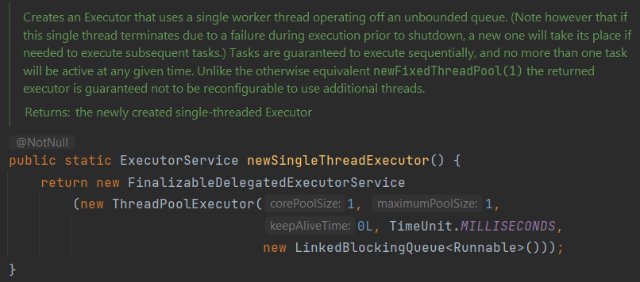
Separate Critical Path
Recent Keys
Values
Notes:
OOMKilled – Kubernetes memory limits

Slide 47
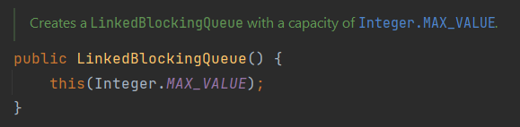
Separate Critical Path
Recent Keys
Values
Notes:
OOMKilled – Kubernetes memory limits

Slide 48
Separate Critical Path
Recent Keys
Values
Circuit Breaker + Bulkhead
<
WCU
RCU
Notes:
CB reacts if bulkhead is full.
Meter bulkhead and DynamoDB throttling

Slide 49

Baseline
15,000 items
Auto Scaling group
HTTP 400
RCU = 400
Notes:
- TODO calculations
- TODO metrics

Slide 50
Retries
No Fairness
Auto Scaling group
HTTP 400
RCU = 400
Retry
Notes:
- TODO calculations
- TODO metrics

Slide 51
Built In Rate-Limiting
Auto Scaling group
40/s
HTTP 400
40/s
RCU = 400
80/s
Notes:
- TODO calculations
- TODO metrics

Slide 52
Built In Rate-Limiting
Rate-Limit Changes
Auto Scaling group
40/s
40/s
HTTP 400
RCU = 400
40/s
120/s
Notes:
- TODO calculations
- TODO metrics

Slide 53


Service Mesh
Needs API Change
Auto Scaling group
HTTP 429
HTTP 400
RCU = 400
120/s
Notes:
- TODO calculations
- TODO metrics

Slide 54
Queuing Theory
15,000 items
4ms
latency = 30s
4ms
500/s

Slide 55
Queuing Theory
10ms
15,000 items
10ms
10ms
latency = 30s
10ms
500/s
10ms

Slide 56
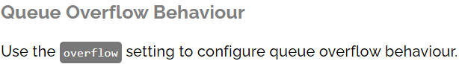
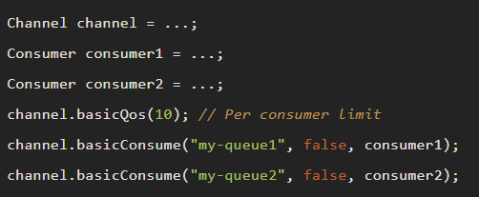
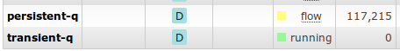
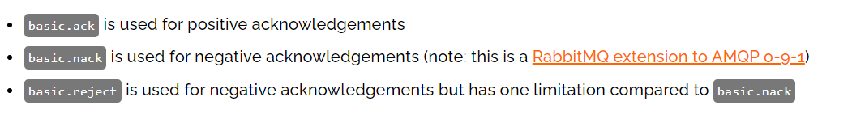
Moving Towards RabbitMQ

Slide 57

Separate by API Keys
Auto Scaling group
API Key
Auto Scaling group
Service
Worker
RCU

Slide 58




DEMO

Slide 59
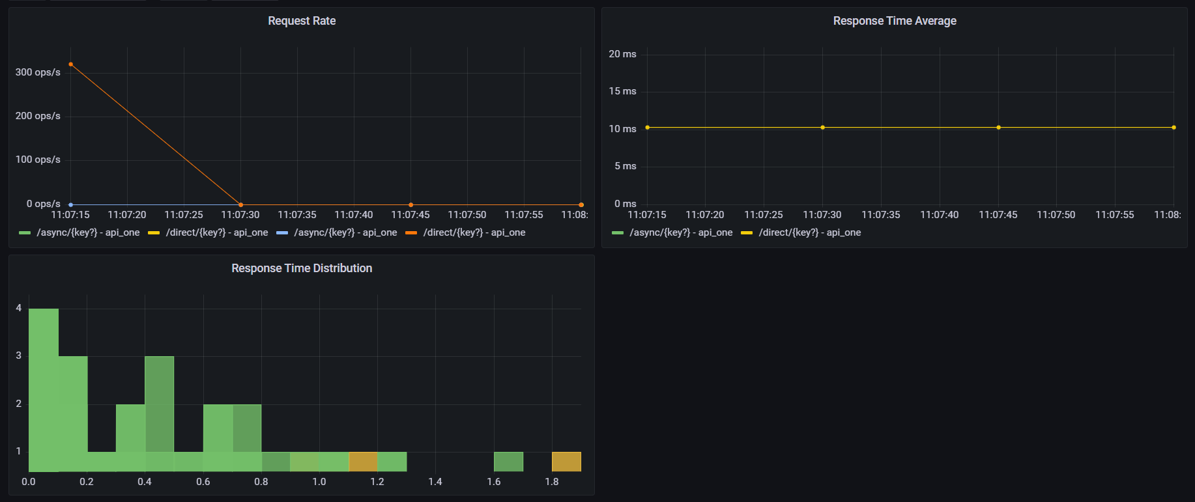
Direct Reads

Slide 60
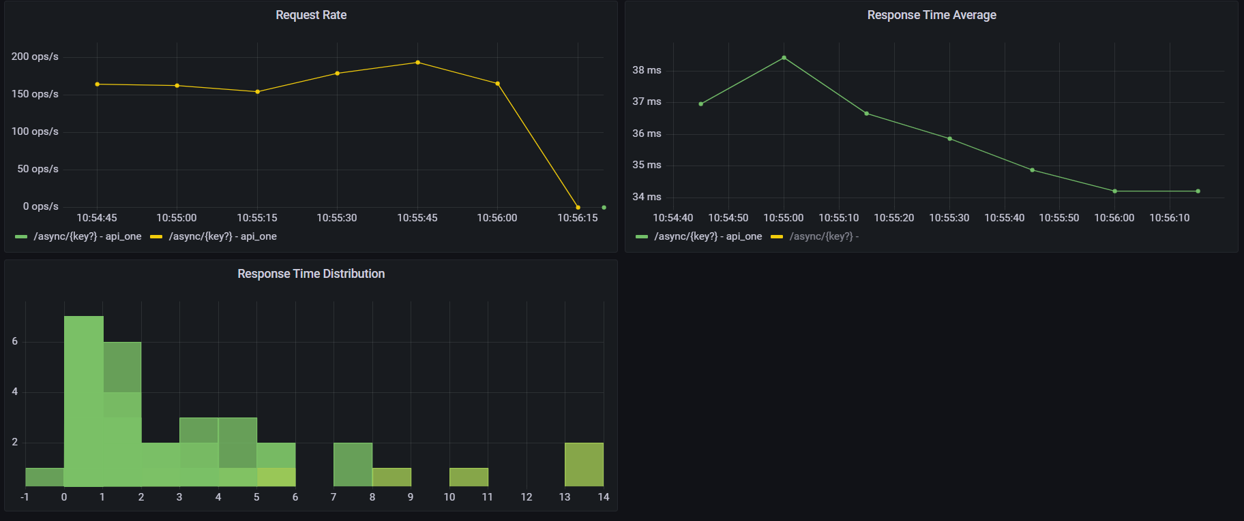
Single Worker
Notes:
TODO - scale

Slide 61
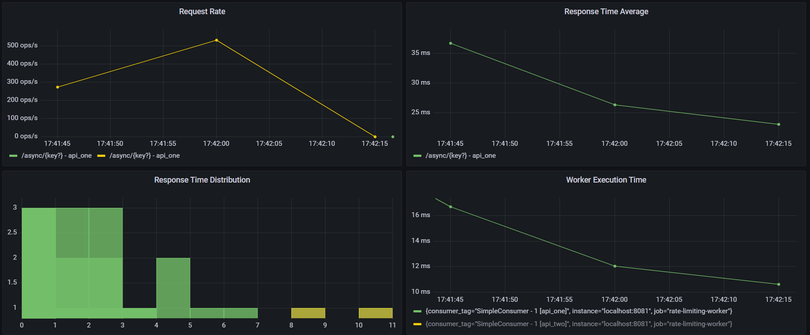
Five Workers
Notes:
TODO - scale

Slide 62





Thank You!
@gitaroktato
gitaroktato
https://www.linkedin.com/in/oresztesz
ORESZTÉSZ MARGARITISZ
ASSOCIATE CHIEF SOFTWARE ENGINEER
Notes:
TODO - SpeakerScore

Slide 63
References
Latency
https://www.igvita.com/2012/07/19/latency-the-new-web-performance-bottleneck/
https://docs.google.com/a/chromium.org/viewer?a=v&pid=sites&srcid=Y2hyb21pdW0ub3JnfGRldnxneDoxMzcyOWI1N2I4YzI3NzE2
https://www.cloudping.co/
https://aws-latency-test.com/
https://colin-scott.github.io/personal_website/research/interactive_latency.html
https://gist.github.com/jboner/2841832
https://blog.bytebytego.com/p/ep22-latency-numbers-you-should-know
Availability
https://github.com/gitaroktato/microservices-availability-simulator
https://eventhelix.com/fault-handling/system-reliability-availability
https://eventhelix.com/fault-handling/reliability-availability-basics
https://en.wikipedia.org/wiki/Fallacies_of_distributed_computing
Notes:
Latency:
https://www.igvita.com/2012/07/19/latency-the-new-web-performance-bottleneck/
https://docs.google.com/a/chromium.org/viewer?a=v&pid=sites&srcid=Y2hyb21pdW0ub3JnfGRldnxneDoxMzcyOWI1N2I4YzI3NzE2
https://www.cloudping.co/
https://aws-latency-test.com/
https://colin-scott.github.io/personal_website/research/interactive_latency.html
https://gist.github.com/jboner/2841832
https://blog.bytebytego.com/p/ep22-latency-numbers-you-should-know
Availability:
https://github.com/gitaroktato/microservices-availability-simulator
https://eventhelix.com/fault-handling/system-reliability-availability/
https://eventhelix.com/fault-handling/reliability-availability-basics/
https://en.wikipedia.org/wiki/Fallacies_of_distributed_computing
Backpressure with SQS
https://d1.awsstatic.com/architecture-diagrams/ArchitectureDiagrams/unreal-engines-pixel-streaming-on-aws-ra.pdf?did=wp_card&trk=wp_card
Reliability:
https://www.joelonsoftware.com/2002/11/11/the-law-of-leaky-abstractions/
Queuing Theory
https://www.youtube.com/watch?v=oQGreeij-OE
https://www.youtube.com/watch?v=raRpbsWQBCo
https://en.wikipedia.org/wiki/Little%27s_law
Rapid-Read Protection:
http://www.datastax.com/dev/blog/rapid-read-protection-in-cassandra-2-0-2
Katas: https://nealford.com/katas/kata?id=GoingGoingGone
Kafka / Kinesis Multi-Region: https://aws.amazon.com/blogs/big-data/increase-apache-kafkas-resiliency-with-a-multi-region-deployment-and-mirrormaker-2/
https://aws.amazon.com/blogs/big-data/build-highly-available-streams-with-amazon-kinesis-data-streams/

Slide 64
References
Backpressure with SQS
https://d1.awsstatic.com/architecture-diagrams/ArchitectureDiagrams/unreal-engines-pixel-streaming-on-aws-ra.pdf?did=wp_card&trk=wp_card
Reliability
https://www.joelonsoftware.com/2002/11/11/the-law-of-leaky-abstractions/
Queuing Theory
https://www.youtube.com/watch?v=oQGreeij-OE
https://www.youtube.com/watch?v=raRpbsWQBCo
https://en.wikipedia.org/wiki/Little%27s_law
https://en.wikipedia.org/wiki/Kendall%27s_notation
https://dzone.com/articles/applying-back-pressure-when
Rapid-Read Protection
http://www.datastax.com/dev/blog/rapid-read-protection-in-cassandra-2-0-2

Slide 65
References
Architecture Katas https://nealford.com/katas/kata?id=GoingGoingGone
Kafka / Kinesis Multi-Region Examples https://aws.amazon.com/blogs/big-data/increase-apache-kafkas-resiliency-with-a-multi-region-deployment-and-mirrormaker-2
https://aws.amazon.com/blogs/big-data/build-highly-available-streams-with-amazon-kinesis-data-streams
The Twelve-Factor App
https://12factor.net/
Rate-Limiting Sandbox
https://github.com/gitaroktato/system-design-excercises/tree/main/rate-limiting
Microservices Availability Simulator
https://github.com/gitaroktato/microservices-availability-simulator

Slide 66
References
Backpressure with RabbitMQ
https://www.rabbitmq.com/maxlength.html
https://www.rabbitmq.com/tutorials/tutorial-six-java.html
https://www.rabbitmq.com/consumers.html#single-active-consumer
https://www.rabbitmq.com/flow-control.html
https://blog.rabbitmq.com/posts/2020/05/quorum-queues-and-flow-control-the-concepts
https://www.rabbitmq.com/consumer-prefetch.html
https://blog.rabbitmq.com/posts/2014/04/finding-bottlenecks-with-rabbitmq-3-3/
https://blog.rabbitmq.com/posts/2015/10/new-credit-flow-settings-on-rabbitmq-3-5-5/
https://www.rabbitmq.com/confirms.html#publisher-confirms

Slide 67
CTS9

Slide 68
Conway’s Law
How does this affect us?
Notes:
Schema owner != Service Owner
“Be liberal in what you accept, and conservative in what you send” - https://www.rfc-editor.org/rfc/rfc1122
Schema Providers:
JSON Schema: https://json-schema.org/
Protocol Buffers: https://developers.google.com/protocol-buffers/
Avro: https://developers.google.com/protocol-buffers/
OpenAPI: https://www.openapis.org/
Schema Registry:
https://docs.confluent.io/platform/current/schema-registry
GraphQL Schema Federation:
https://www.apollographql.com/docs/federation/federated-types/overview/

Slide 69

Colors

